Slide 1
Sentien Payload Delivery System
Berkeley Engineering Solutions
Spring 2023
Khaled, Asusena, Reagan, Aashrith

Slide 2
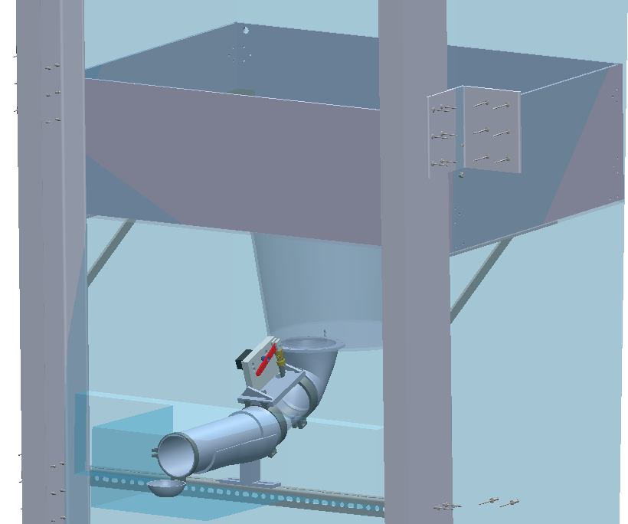
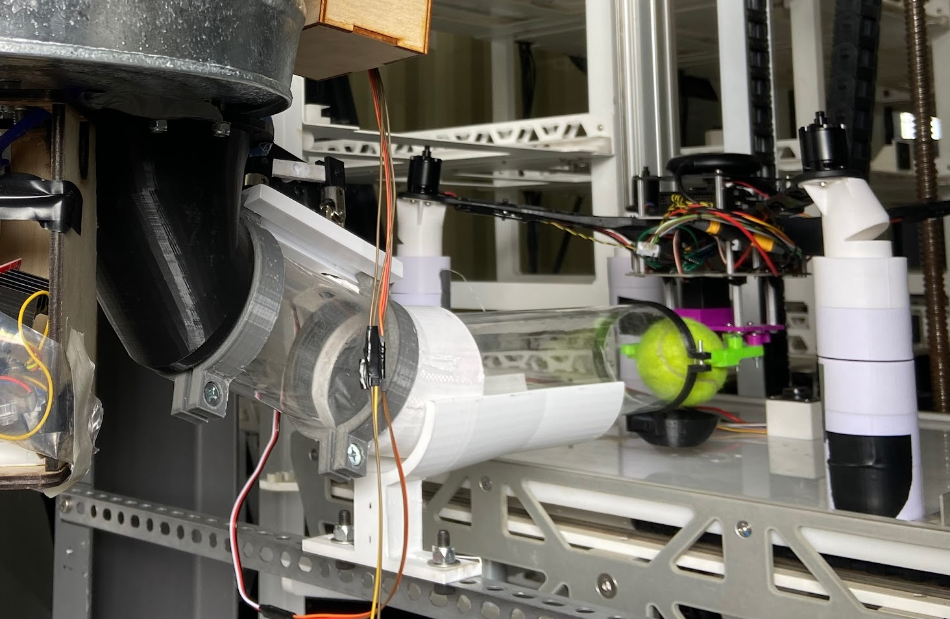
Full Project Assembly

Slide 3
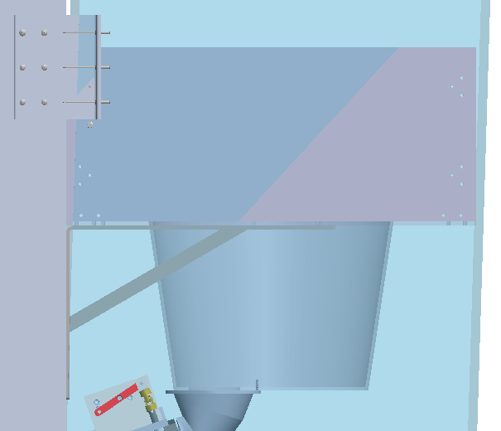
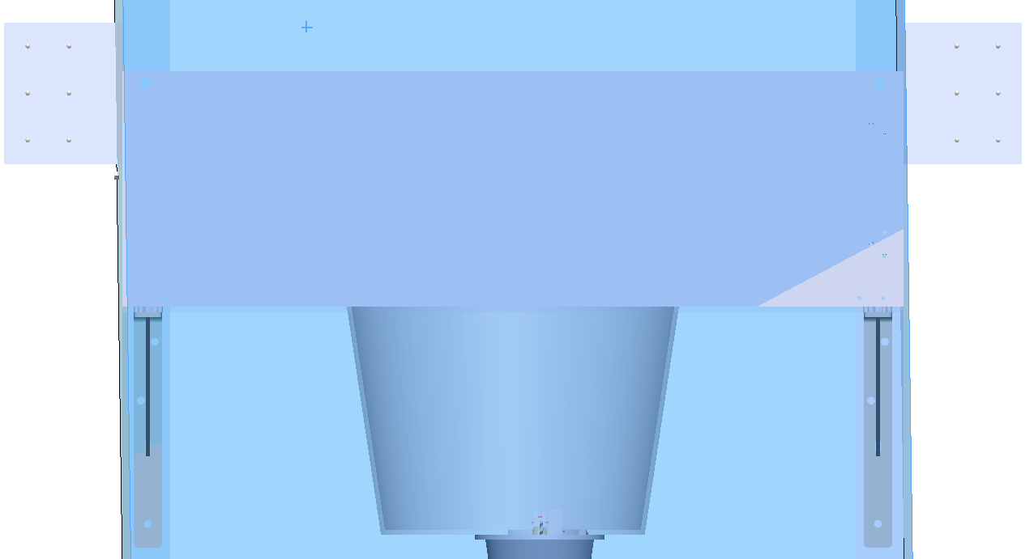
Container Subsystem
5x ¼” acrylic panels assembled together with brackets and bolts
Laser cut for proper size and bolt holes
Circular hole in the bottom panel to fit the active paneling system (circular rim of bucket; See next slide)
Two holes to attach rope from trailer for extra support

Slide 4
Active Funneling Subsystem
A passive funnel that connects the container to tubing would jam as multiple tennis balls would clog together near the narrow end of the funnel
The active funnel system solves that by letting one ball into the tube at a time.
Steel bucket with a hole on the bottom.
Integrated spinning plate with 4 cutouts for balls
As balls fall into the bucket, they fill the slots in the plate, which spins and thus drops one ball into the hole at a time
Spinning plate powered by:
30 rpm, 12 volt DC motor
3 Li-ion 3.7 volt batteries
Arduino Uno + L298N Motor Drive Controller
To support weight of tennis balls, 4 ball transfers placed under the spinning plate
Housing for electronics

Slide 5
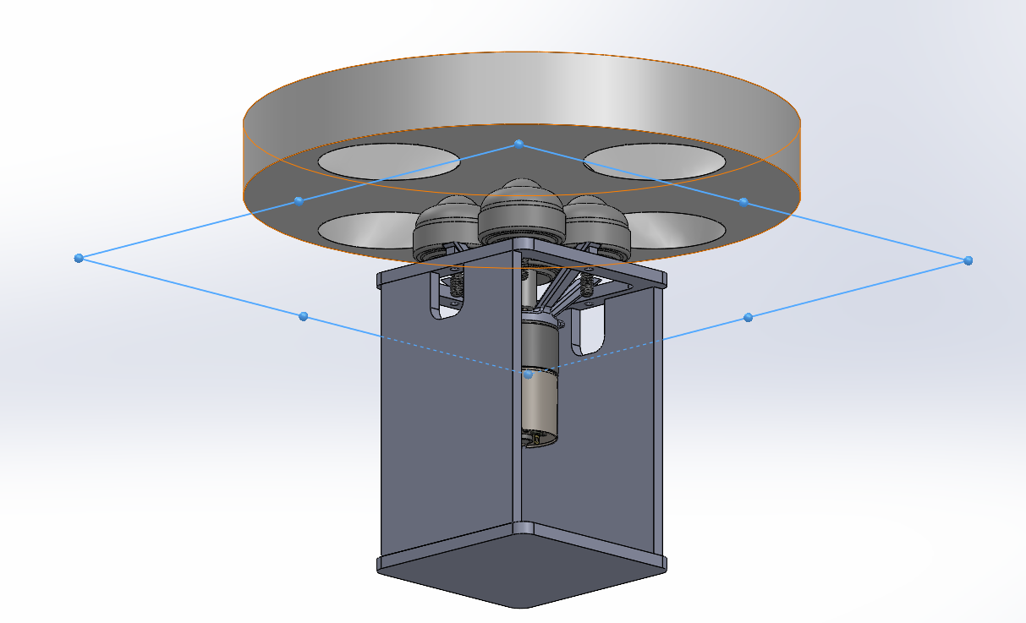
Active Funneling Subsystem
Spinning Plate
Spinning Plate
4x Ball Transfers
Motor Mount
DC Motor
Electronics
Housing
Highlighted plane is
the location of the bottom of the bucket
*Steel bucket is hidden. See location of bottom plate.

Slide 6
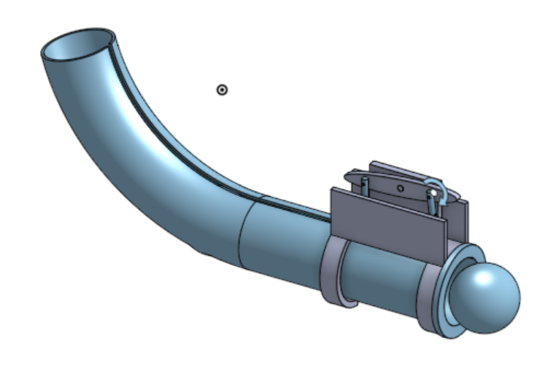
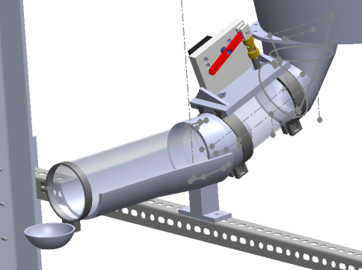
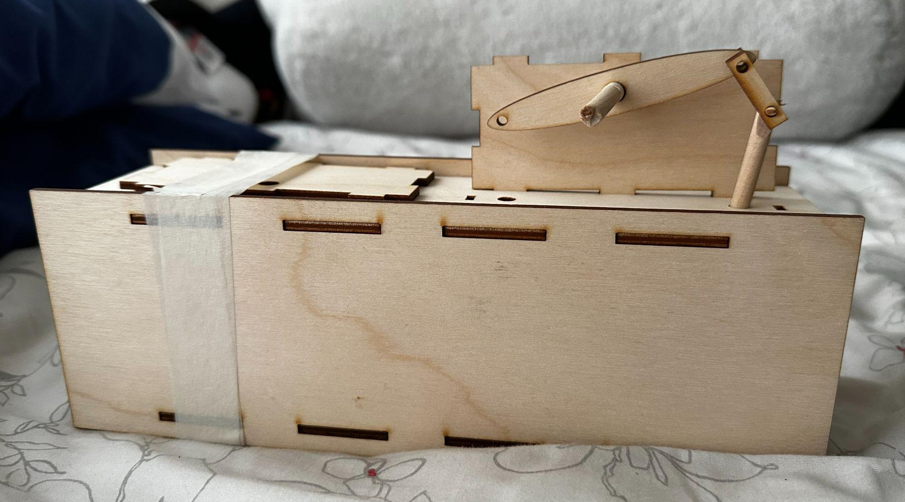
Indexing Subsystem
inspired by skee-ball indexing mechanism
a tube system connecting the active funneling subsystem to the end effector subsystem
involves use of universal joints (with rods that insert into the tube) connected to horn adapters, which are connected to a custom-printed servo horn
use of a DS3235 35KG Coreless Stainless Steel Gear Waterproof Digital Servo
Oscillation between 0 to 15 degrees with the click of a push button (Arduino Nano, 10k Ohm resistor)
initial index design
laser-cut prototype
final CAD design

Slide 7
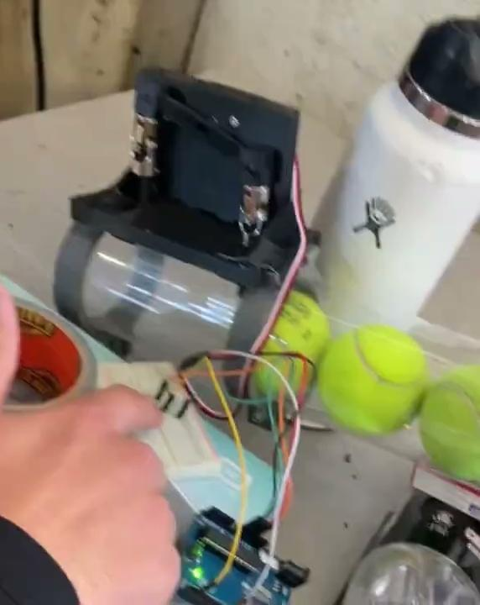
indexing system mounted on trailer
Video of indexing function

Slide 8
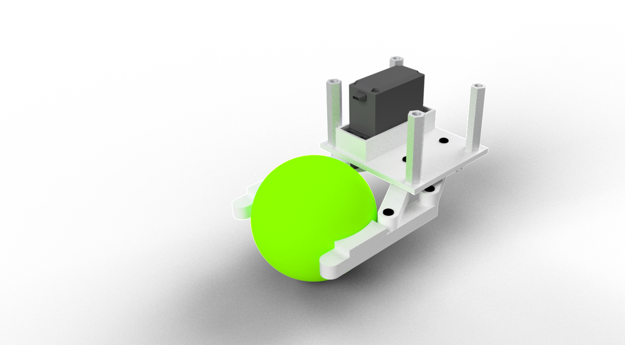
End-Effector Subsystem
Prototyped multiple designs for End-Effectors (Linkage, Worm Gears, Different Number of End Effectors)
Ended up with 2 armed linkage system
S3003 Servo utilized in the mechanism, with stall torque of 3.2 kg/cm
Powered with 9V battery, Arduino Nano and HC-05 Bluetooth module
All Electronics stored away from the actuator, in middle area of the drone to limit footprint
Bluetooth module used to allow for wireless control for a mechanism that is going to be inaccessible most of the time
Future Changes:
Reducing standoff sizes to attach with bottom plate of drone, as opposed to adhesive that is currently use.

